Slide 1
AI BASED ADVOCHAT
Guide Name : Smt.Shiny B PRESENTED BY,
Anju Krishna
Roll no: 10

Slide 2
INTRODUCTION
The project gathers information on local lawyers, including ratings, cases won, and fees.
Users can sort lawyers by rating, cases, or fees and learn about different advocate types.
A chat feature lets users interact directly with lawyers.
The platform includes IPC sections for users to verify filed cases against them.

Slide 3
LITERATURE REVIEW
SLN | PAPER TITLE | AHUTORS | YEAR OF PUBLISHING | ADVANTAGE | LIMITATIONS
1 | The implications of ChatGPT for Legal Services and Society | Andrew Perlman | 2023 | It obtain legal and other services, and prepare people for their careers. | It is imperfect and at times Problematic.
2 | Lawyer’s Work Management at Law Firms | Tharani Kawya | 2020 | This research emphasizes the digitization of business processes within a law chamber. | The proposed system under this research paper is to be developed with the functionalities:chatbot communication,email management.
3 | Consumer preceptions of online legal service | Vicki Waye ,Timofei Bogomolov, Anja pich | 2020 | Web-based review and rating services | The ability to convey trust and confidence is not maintained.

Slide 4
SLN | PAPER TITLE | AHUTORS | YEAR OF PUBLISHING | ADVANTAGE | LIMITATIONS
4 | Online Legal Service:The Present and Future | Aminur Islam,Jannatul Ferdaus,Abbas Ali Khan and Tarek Habib | 2018 | In characterizing client focused models for online legitimate help services,understandings of how people utilize the internet to get lawful help. | The client needs,inclinations,and work processes archived here can be checked in more broad observational and future investigations.
5 | Adoption of online legal services by law firm | Prian Naicker | 2017 | It is directed at empirically identifying the technological,organisational and environmental factors that influence the adoption of online legal services. | It was not able to locate other studies into online legal services adoption which indicates that the legal industry is a new context for the application of adoption theories.

Slide 5
PROBLEM STATEMENT
To Develop an " AI Based Advochat " Platform to streamline the process of connecting user with suitable Lawyers.

Slide 6
EXISTING SYSTEM
Lack of legal awareness in the general public.
Dependency on direct meetings with lawyers for legal help.
Time-consuming and challenging process for seeking legal assistance.
Manual collection of data required to find a specific category of lawyer.
Proposed system aims to address these issues efficiently.

Slide 7
PROPOSED SYSTEM
User-friendly legal support platform.
Browse registered lawyers by expertise.
Book appointments online.
Site acts as a legal services agency.
Chat module for lawyer-user communication.
Admin manages request formalities.

Slide 8
REQUIREMENT SPECIFICATION
SOFTWARE REQUIREMENTS
Operating system: Windows
Web technologies: python, Django, HTML, CSS
Database : MySQL
Web browser: Google Chrome/Mozilla Firefox
HARDWARE REQUIREMENTS
Processor –i3 or Higher
Hard Disk –50 GB
Memory–1GB RAM or Higher

Slide 9
ARCHITECTURE DIAGRAM
USER
Register
ADMIN
View advocate
Login
Add IPSC
ADVOCATE
View IPSC
View customer
View advocate
View category
View IPSC
Add category
Add feedback
View category
View feedback
Book Advocate
View case request
View case Status
View advocate
Add feedback

Slide 10
USE CASE DIAGRAM
Add IPSC
View customer
Add category
View feedback
View advocate
ADMIN
View IPSC
View category
View case request
Add Feedback
CUSTOMER
Book advocate
ADVOCATE
View case status

Slide 11
ALGORITHM USED
Rule-Based Approach: Rule-based chatbots operate on predefined rules and patterns. Each possible user input has a corresponding rule or set of rules that dictate the appropriate response.
Algorithm:
Step1: Input:The chatbot receives user input, typically in the form of text.
Step 2: Intent Matching: The system compares the user input against predefined patterns associated with different intents. These patterns are specified in the “patterns” field for each intent in the provided JSON structure. Step 3: Context Determination: If the chatbot needs to consider the context of the conversation, it can analyze the conversation history or maintain a context state. Step 4: Response Generation: Based on the matched intent and, if applicable, the context, the chatbot selects a response from the predefined set of responses associated with the matched intent. Step 5: Output: The generated response is provided to the user, completing the interaction. Step 6: Repeat: The process is repeated for each user interaction, allowing the chatbot to handle a sequence of inputs and maintain context if necessary.

Slide 12
MODULES
The modules included in this project are:
Admin
User
Advocate

Slide 13
MODULE FUNCTIONS
Admin:
Login: Admin can login into system using their valid credentials.
View Request: New Lawyers and users who have been registered into the system will get the access after admin’s approval.
View Cases: Admin can keep a look on the cases posted by user's and even delete them if found inappropriate.
View Users: Registered users will be displayed to the admin with their details.
Edit / Delete User's: Admin can edit or delete a user if required.
View Feedback: Can view all the feedback’s.
Add IPC Section: Can add all the IPC sections.

Slide 14
User:
Registration: New customer need to register first with their basic registration details as well as qualification details.
Login: customer can login into the system once he/she is verified by the admin. customer need to enter valid login credentials in order to access the system.
Send Feedback: if a user is facing any issue, he/she can send feedback to admin.
View IPC sections: Customers can view IPS sections.
View Advocates: Registered advocates can be viewed by the user.

Slide 15
Advocate:
Registration: New lawyer need to register first with their basic registration details as well as qualification details.
Login: Lawyer can login into the system once he/she is verified by the admin. Lawyer need to enter valid login credentials in order to access the system.
View Cases: All the cases, which were raised by the user, will be displayed to the lawyer to learn every case. Lawyers can have a look on the cases posted by users, and they can have the case details and view any image if added. If they are interested in any of the case, he/she can write a message and send a request to a user.
Send Feedback: if a lawyer is facing any issue, he/she can send feedback to admin.

Slide 16
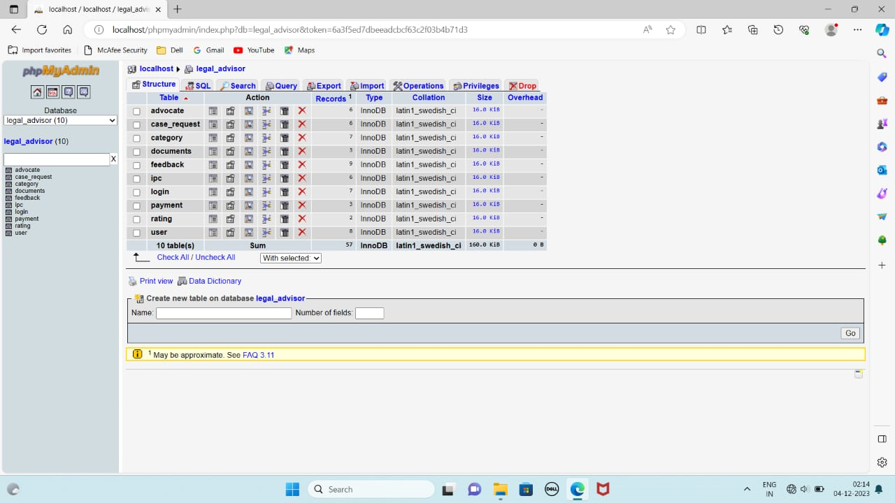
DATABASE CONNECTION

Slide 17
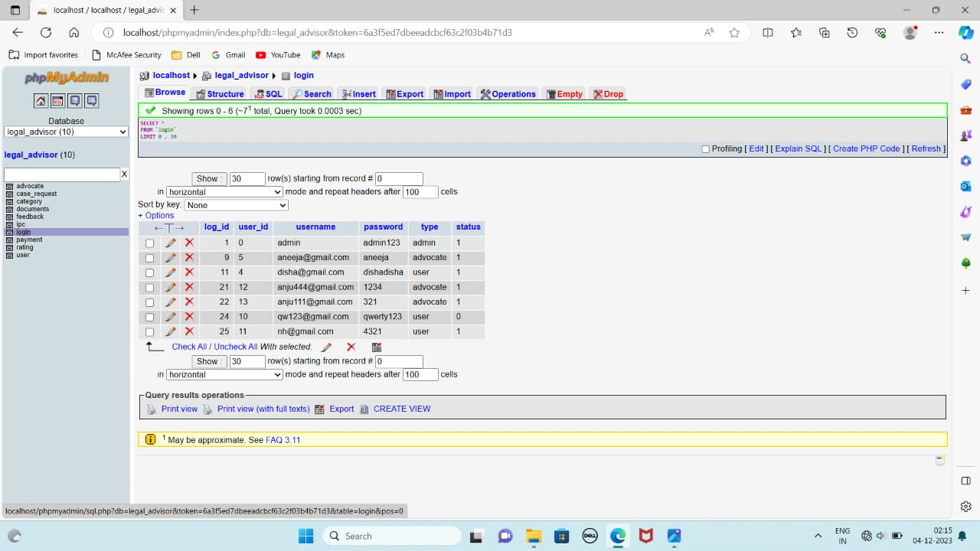

Slide 18
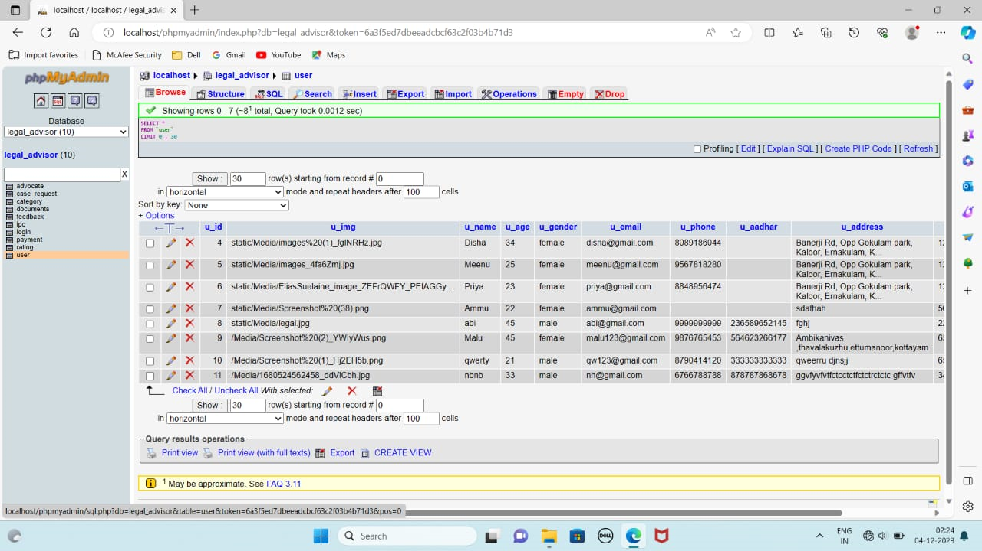

Slide 19
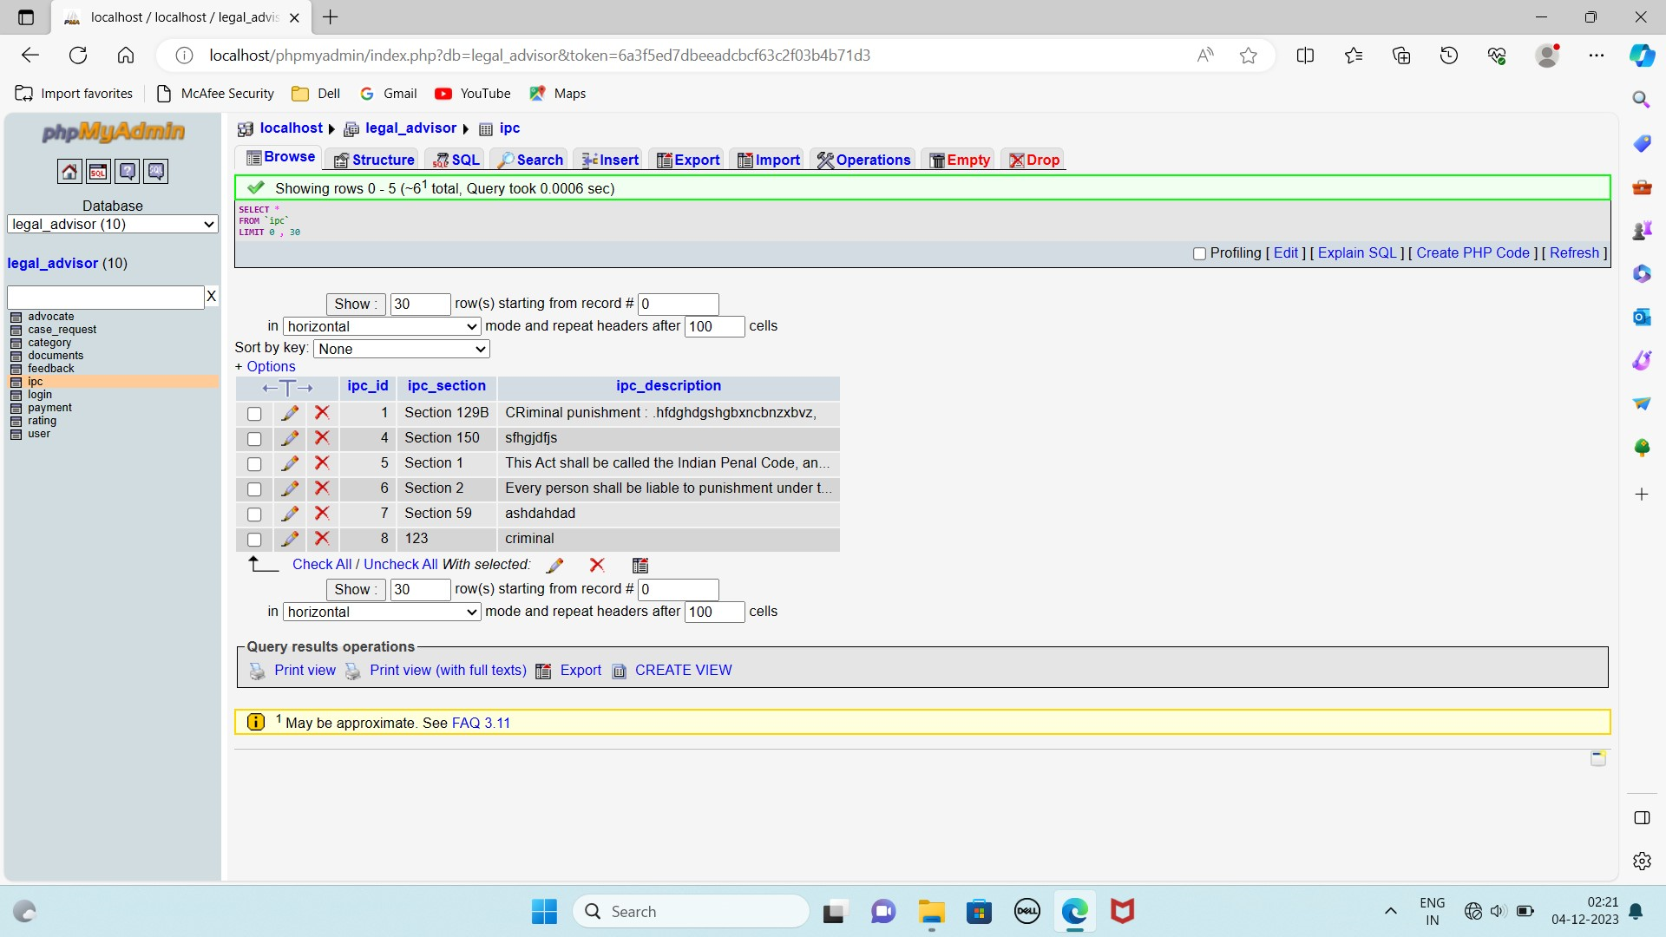

Slide 20
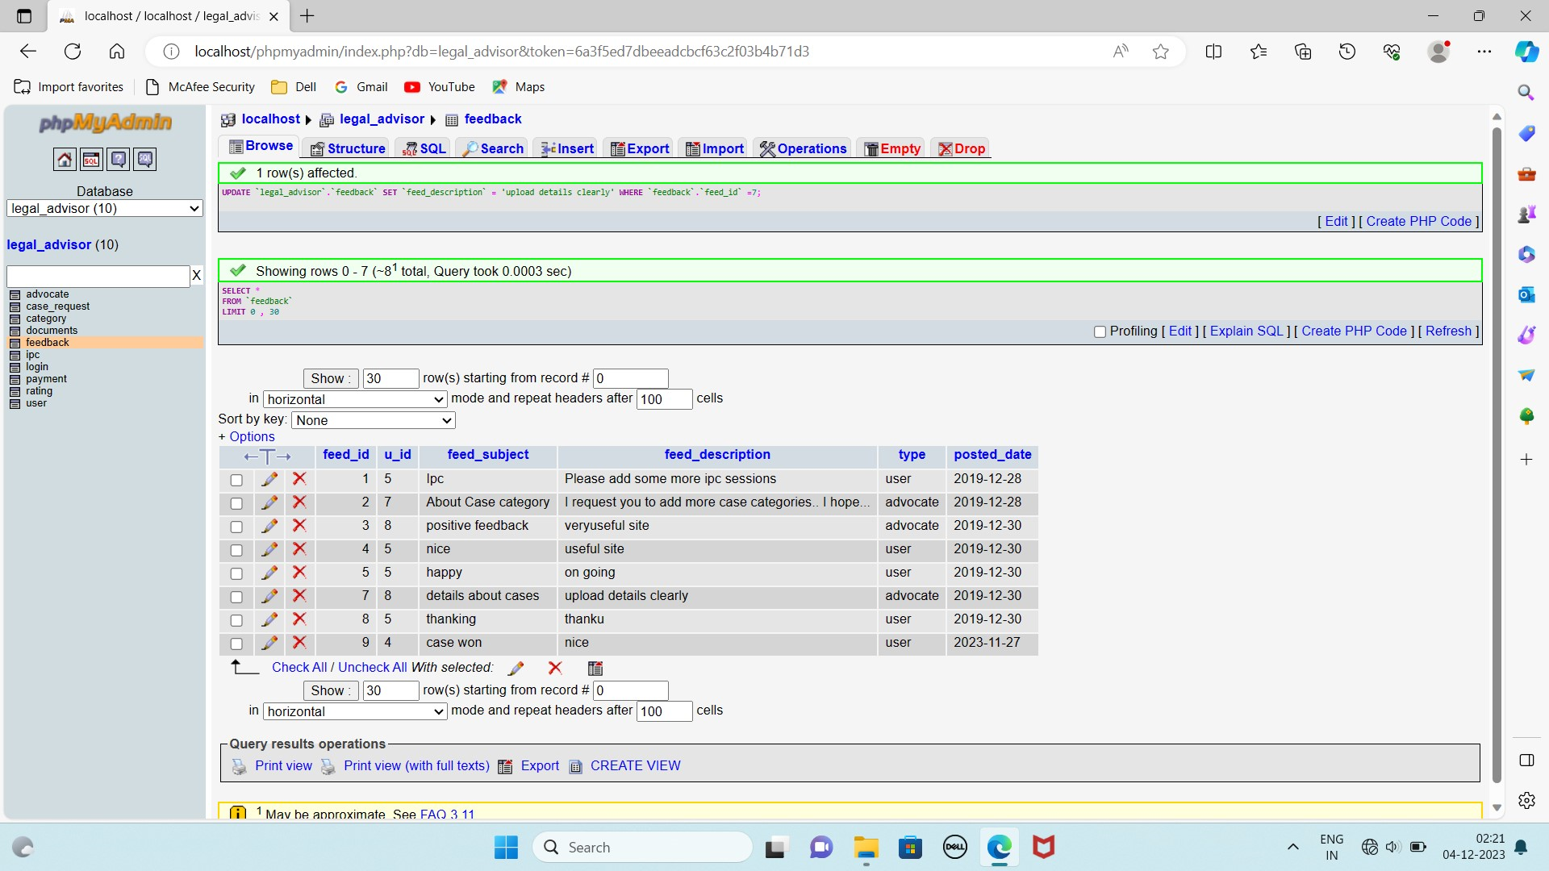

Slide 21
SYSTEM TESTING
TEST CASES
Step no: | Steps | Data | Expected results | Actual results
1 | Enter User name and press LOGIN Button | User name = admin | Should display warning message box "Please Enter Password" | Login failed
2 | Enter Password and press LOGIN Button | Password = admin | Should display warning message box "Please Enter User name” | Login failed
3 | Enter User name and Password and press LOGIN Button | Username = admin and Password = admin | Should display Admin page | Login Success
4 | Enter User name and Password and press LOGIN Button | Username = amal and Password = 1234 | Should display Amal's page | Login Success

Slide 22
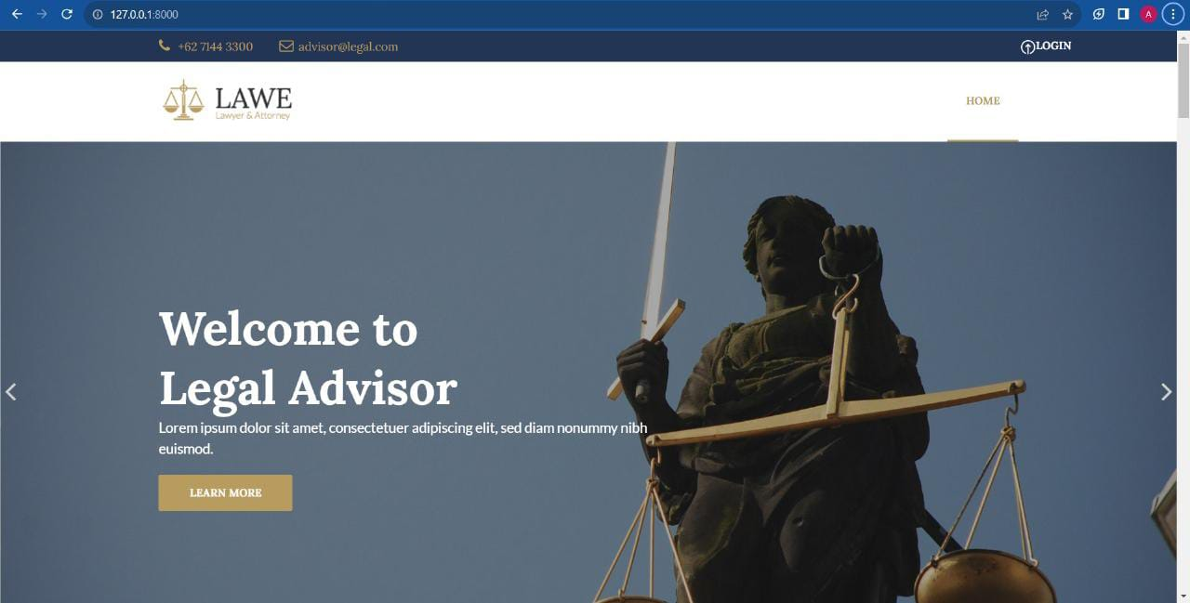
RESULT SCREENSHOTS

Slide 23
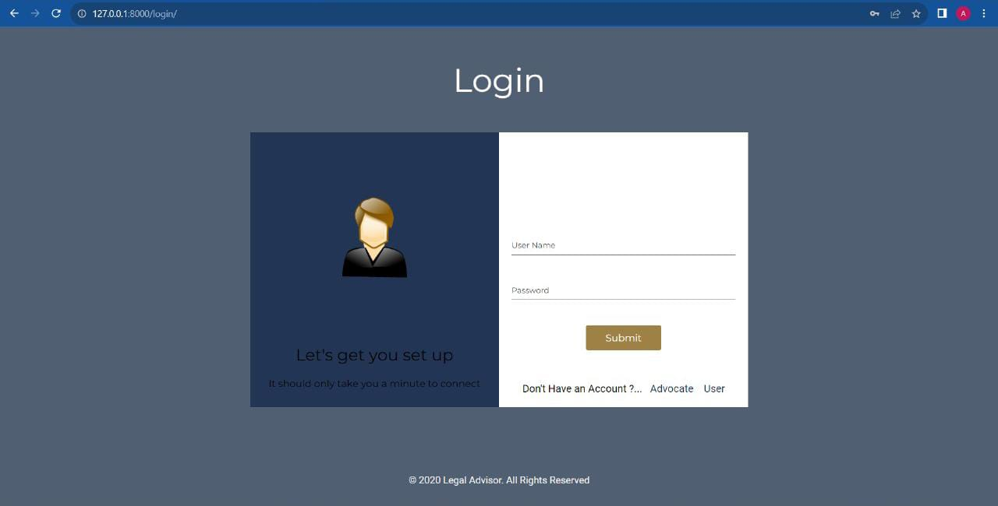
LOGIN PAGE

Slide 24
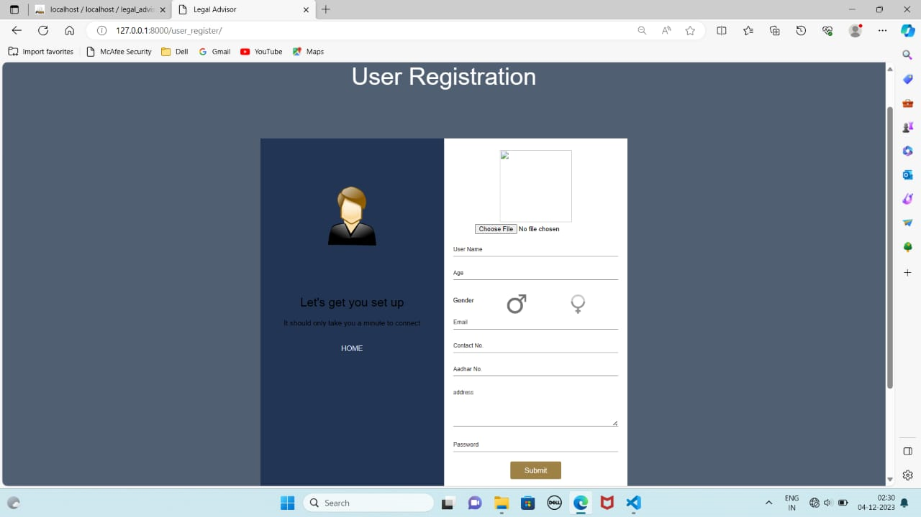
USER REGISTRATION

Slide 25
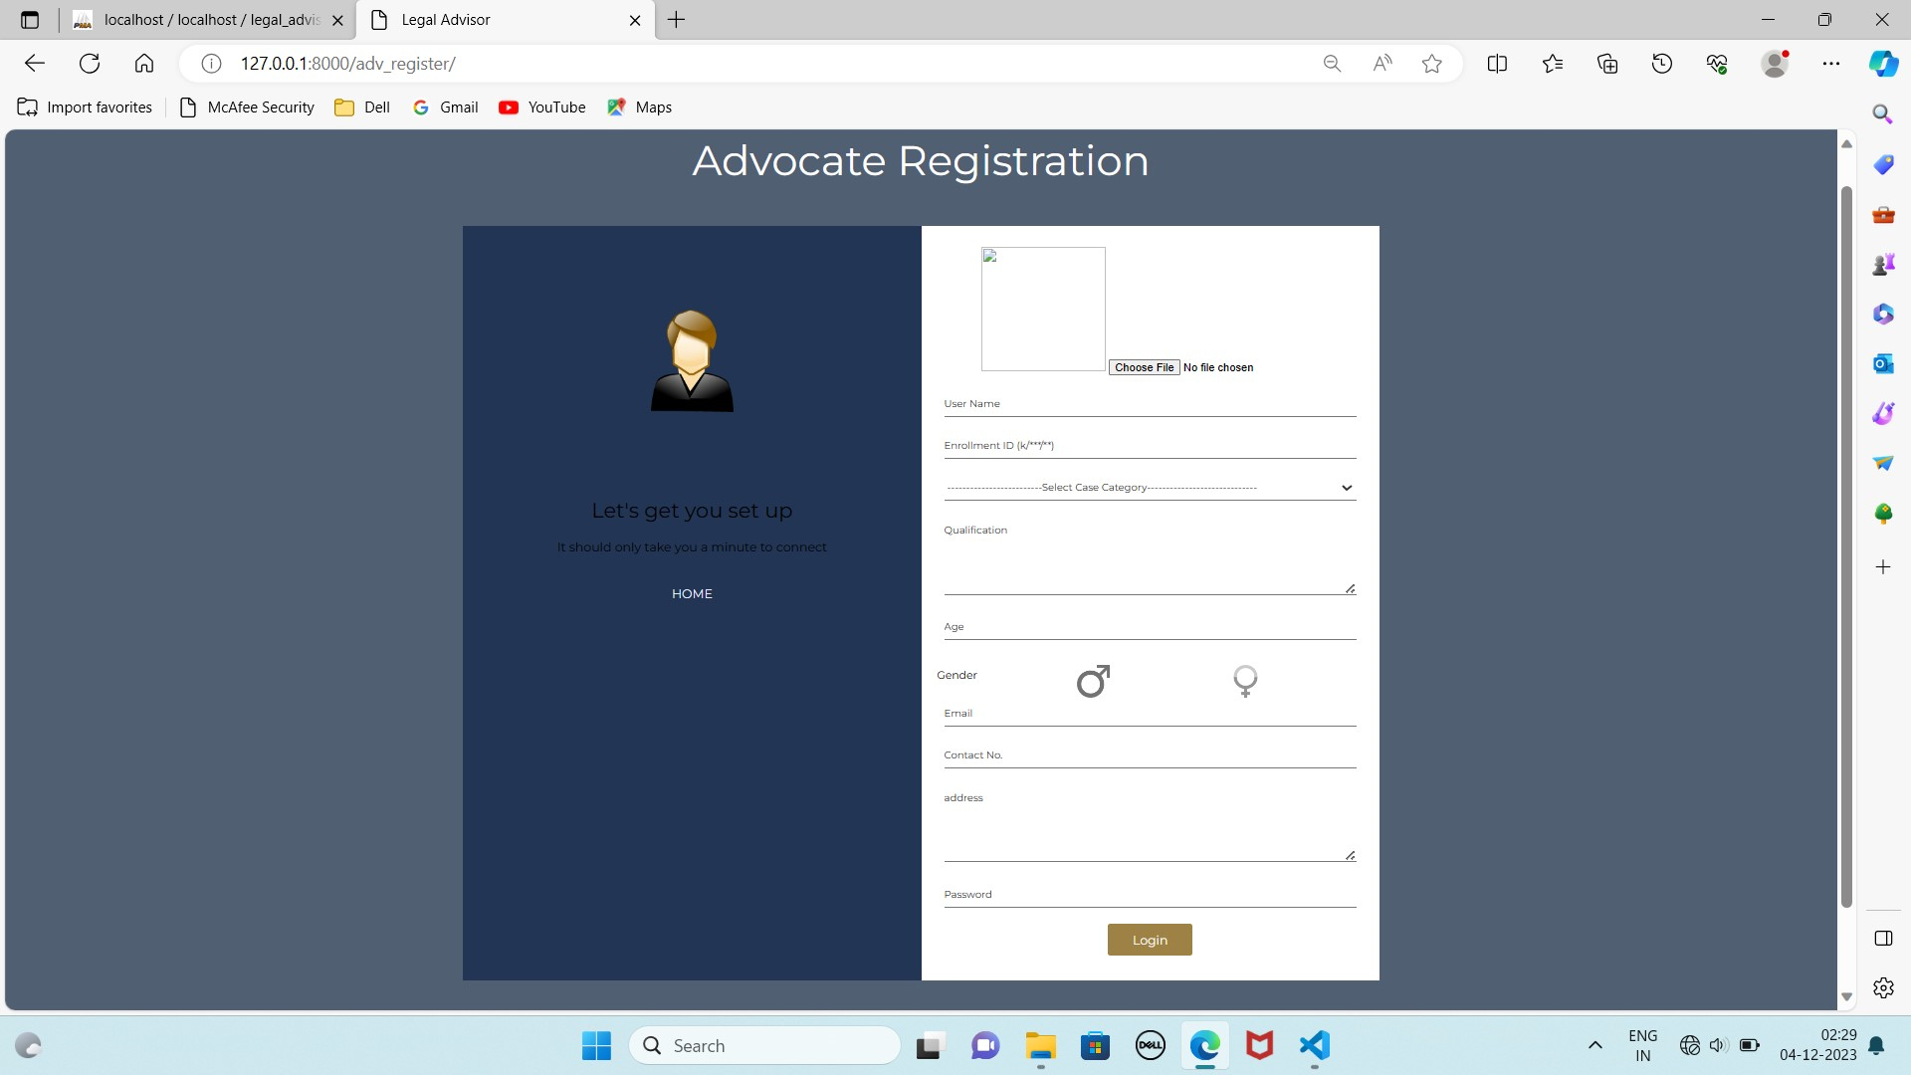
ADVOCATE REGISTRATION

Slide 26
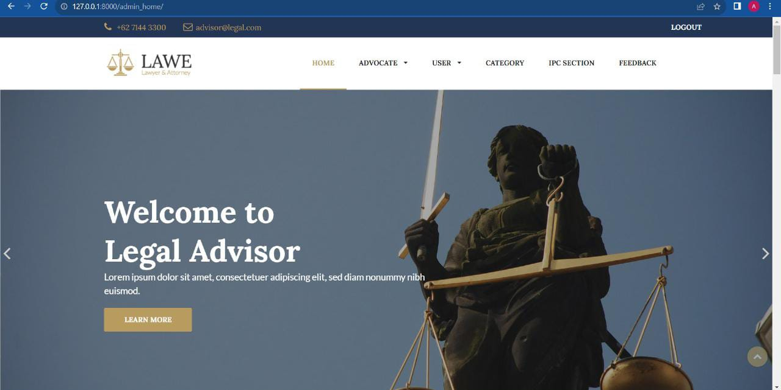
ADMIN PAGE

Slide 27

ADVOCATE PAGE

Slide 28
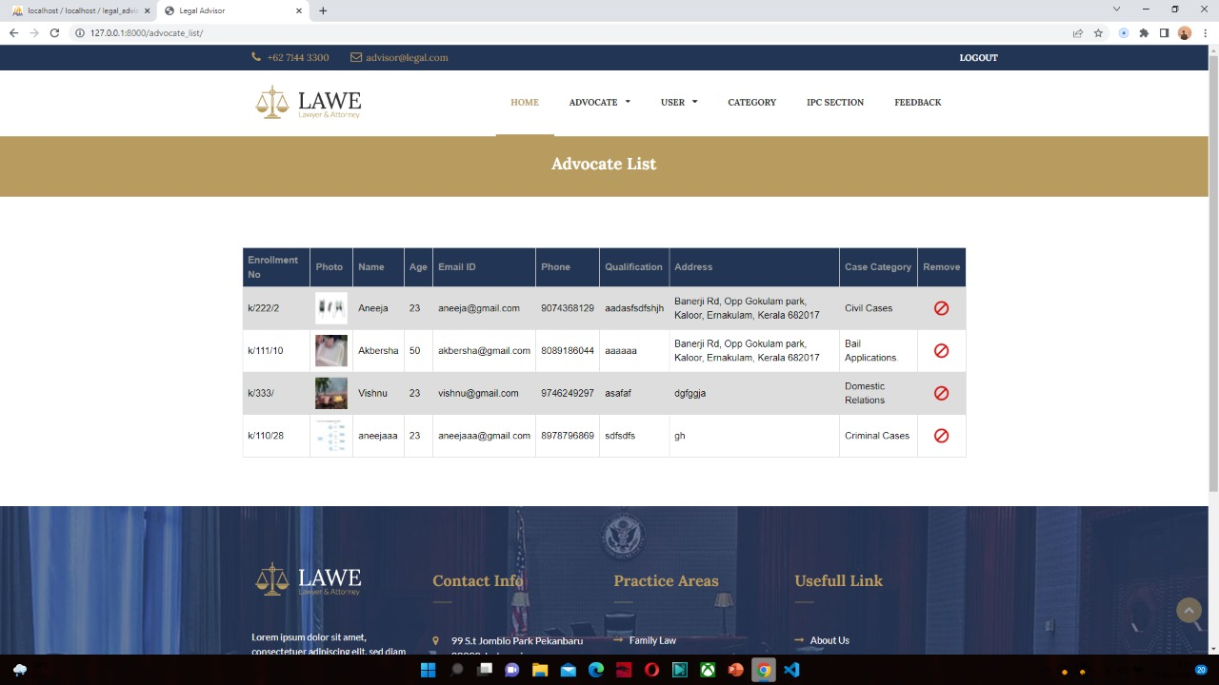
ADOCATE LIST

Slide 29
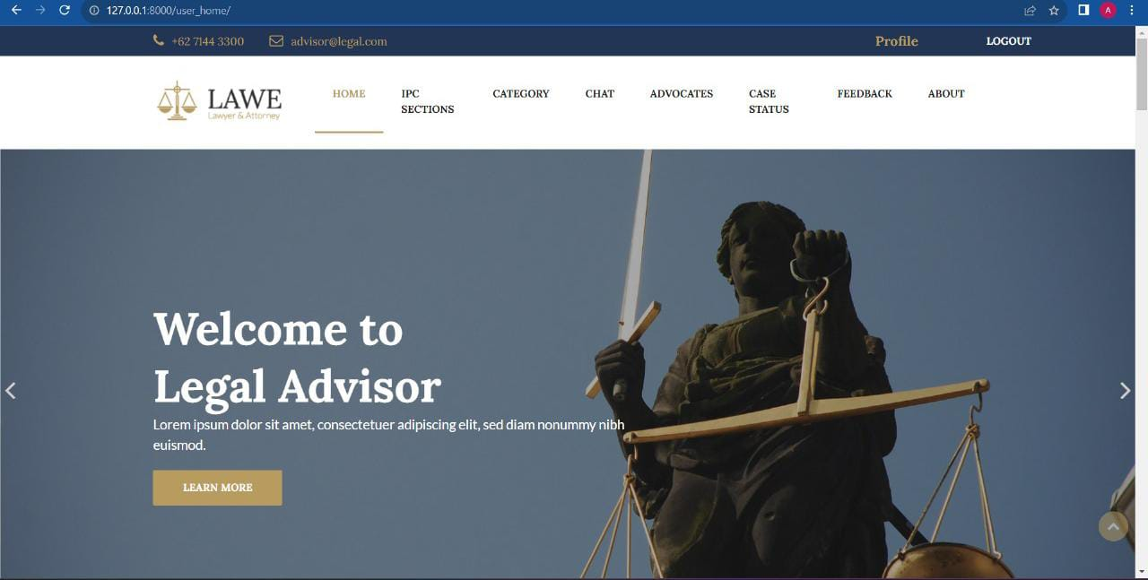
USER PAGE

Slide 30
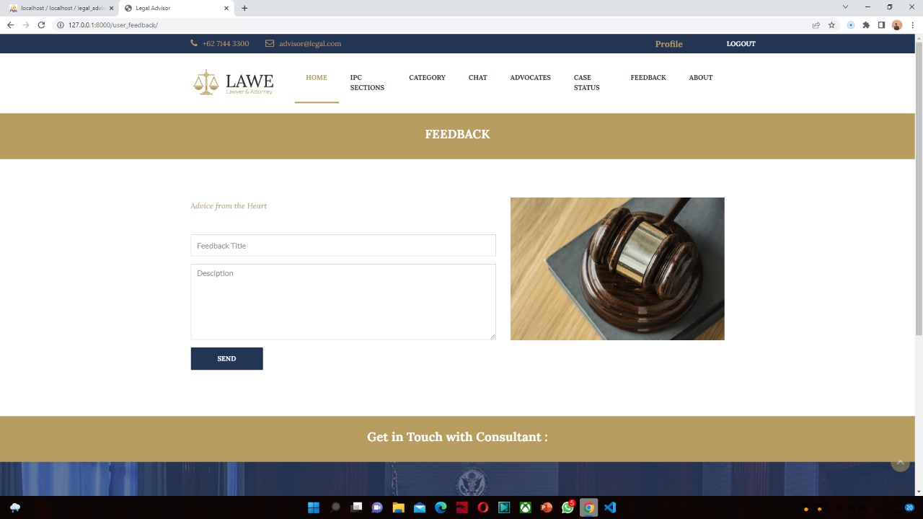
FEEDBACK PAGE

Slide 31
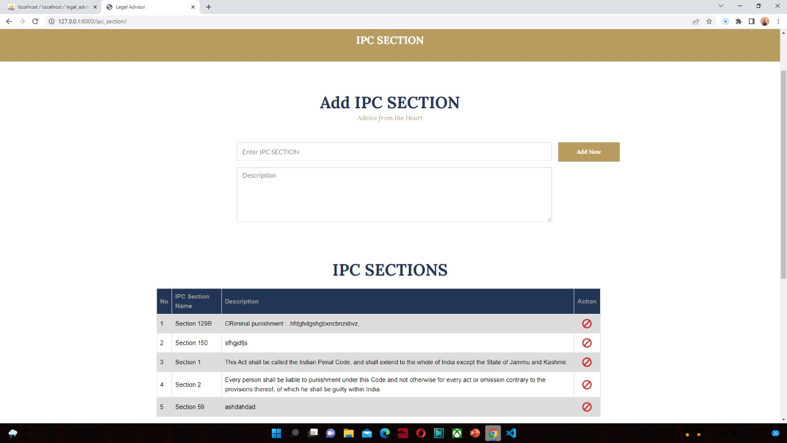
IPSC PAGE

Slide 32
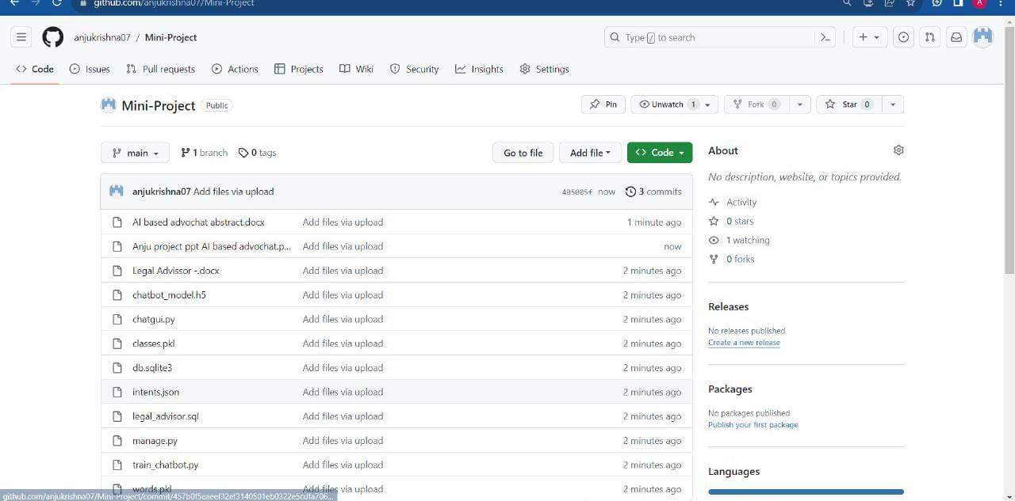
GITHUB HISTORY

Slide 33
FUTURE SCOPE
In future since each and every application should expand and it should provide a way for updating the system has been developed.
All modules in the system are being developed carefully such that the future enhancement does not affect the basic performance of the system.
The main enhancements of the project are:
To encrypt files that are attached by the user
To use multiple encryption algorithms
Considering about creating a mobile application.

Slide 34
CONCLUSION
The relevance of the project is clear, since the implementation of the system is very easy.
Even though the computer and its applications are rapidly becoming popular, only a few established organization, companies and educational institutions are automatic the system. The others just continue with the old type of processing, which is the manual system.
The new system “AI based AdvoChat” thus obtains the full certificate of achievements in handling all users with full satisfaction.
A trial run of the system has been made and is giving good results.

Slide 35
REFERENCES
AN INTRODUCTION TO PYTHON - Guido van Rossum
HTML 5 & CSS MADE SIMPLE - Ivan Bayross
JAVASCRIPT: THE DEFINITIVE GUIDE - David Flanagan
THE DEFINITIVE GUIDE TO USING,
PROGRAMMING AND ADMINISTERING MYSQL4 - Paul DuBois
WEBSITES VISITED
www.google.com
www.w3schools.com
www.wikipedia.com

